Slide 1




Phone Book Application
19SW01
AFSA RIAZ

Slide 2
IDENTIFICATION OF PROBLEM WHERE DATA STRUCTURING IS NECESSARY
1
A phone book application is very basic and common software application. Its basic contents are names and their contacts and addresses.
The need of data structuring for a phone book application comes up with the idea that this application is usually capable of performing operations like adding contacts, deleting contacts, searching some specific contacts and other operations.
These operations related to phone book application needs to be fast and efficient. For this reason the implementation of proper data structure is essential in this case.

Slide 3
PROPER USE OF DATA STRUCTURE
2
This application can be achieved by using different implementations like
Arrays
Hash Tables
Doubly Linked Lists
Array based implementation of phone book app is not much recommended because it has many demerits as compared to merits. Arrays are static and fixed in size. Insertion and removal operations are very slow in arrays.
Hash Tables can be used but in case of hash tables collision and rehashing occurs very frequently.

Slide 4
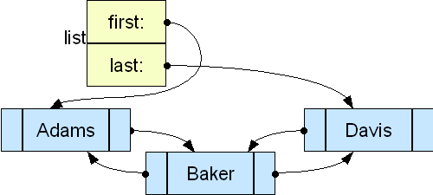
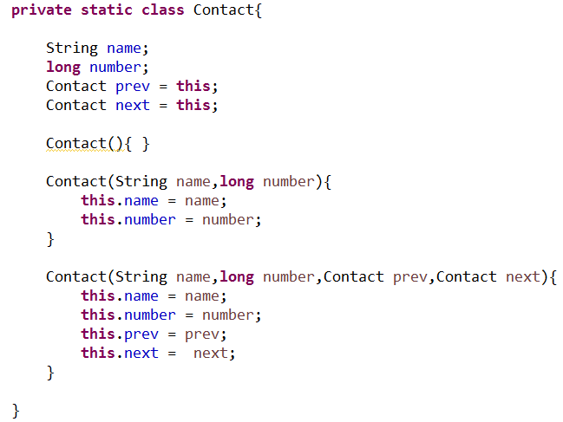
DOUBLY LINKED LISTS
By implementing it using a doubly linked list can make the basic operations like adding and removal comparatively fast and efficient as linked lists are dynamic in nature and compliments operations like insertion and deletion.

Slide 5

ORIGINALITY OF THE PROJECT
3
Based on real ideas and thoughts
Nothing has been copy pasted from the internet
Own version of phone book program
Notes:
Once you find your sources, you will want to evaluate your sources using the following questions:
Author:
Who is the author?
Why should I believe what he or she has to say on the topic?
Is the author seen as an expert on the topic? How do you know?
Current:
How current is the information in the source?
When was the source published?
Is the information out-of-date?
Accuracy:
Is the content accurate?
Is the information presented objectively? Do they share the pros and cons?

Slide 6
ADEQUACY OF THE SOLUTION PROVIDED
4
Using doubly linked list insertion, removal and view methods became fast and efficient.
For sorting methods arrays are used because it is difficult to sort linked lists and sorting can be easily done in arrays.
Just for search method all the data is converted into hash table and then search operation is performed.
Notes:
When conducting research, it is easy to go to one source: Wikipedia. However, you need to include a variety of sources in your research. Consider the following sources:
Who can I interview to get more information on the topic?
Is the topic current and will it be relevant to my audience?
What articles, blogs, and magazines may have something related to my topic?
Is there a YouTube video on the topic? If so, what is it about?
What images can I find related to the topic?

Slide 7
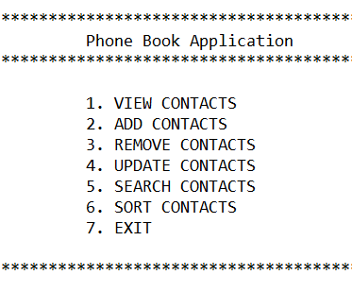
COMPLETENESS OF THE PROJECT
5
This application has almost all functions that a usual phone book application contains.
Different methods for all the operations as well.
Proper validation checks are used.

Slide 8
Thank You!
Notes:
You can use this slide as your opening or closing slide. Should you choose to use it as a closing, make sure you review the main points of your presentation. One creative way to do that is by adding animations to the various graphics on a slide. This slide has 4 different graphics, and, when you view the slideshow, you will see that you can click to reveal the next graphic. Similarly, as you review the main topics in your presentation, you may want each point to show up when you are addressing that topic.
Add animation to images and graphics:
Select your image or graphic.
Click on the Animations tab.
Choose from the options. The animation for this slide is “Split”. The drop-down menu in the Animation section gives even more animations you can use.
If you have multiple graphics or images, you will see a number appear next to it that notes the order of the animations.
Note: You will want to choose the animations carefully. You do not want to make your audience dizzy from your presentation.

